Slide 1
Human Computer Interaction
Designing the User Interface:
Strategies for Effective Human-Computer Interaction
Fifth Edition
Ben Shneiderman & Catherine Plaisant
in collaboration with
Maxine S. Cohen and Steven M. Jacobs

Slide 2
Definition of HCI
Human-computer interaction is a discipline concerned with the design, evaluation and implementation of interactive computing systems for human use and with the study of major phenomena surrounding them.
ACM SIGCHI (Special Interest Group on Computer–Human Interaction)Curricula for HCI (Hewett et al. 1992) https://sigchi.org/

Slide 3
Why HCI is Important
The study of our interface with information.
It is not just ‘how big should I make buttons’ or ‘how to layout menu choices’
It can affect
  Effectiveness
  Productivity
  Morale
  Safety
Example: a car with poor HCI
Take 5 minutes for everyone to write down one common device with substantial HCI design choices and discuss with the neighbor the pros and cons. How does it affect you or other users?

Slide 4
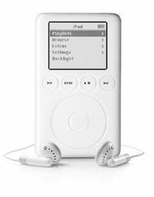
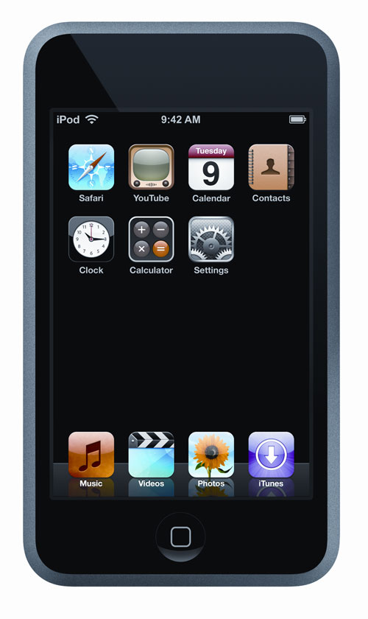
My Choice
iPod by Apple Computers
Pros:
  portable
  power
  ease of use
  # of controls
Cons:
  scratches easily
  compatibility
  proprietary

Slide 5
What is an interface?
?

Slide 6
What is an interface?
A point where two systems, subjects, organizations, etc., meet and interact.
Interact with another system, person, organization, etc.
- In Computing:
A device or program enabling a user to communicate with a computer.
Connect with (another computer or piece of equipment) by an interface.

Slide 7
Evolution of HCI ‘interfaces’
50s - Interface at the hardware level for engineers - switch panels
60-70s - interface at the programming level - COBOL, FORTRAN
70-90s - Interface at the terminal level - command languages
80s - Interface at the interaction dialogue level - GUIs, multimedia
90s - Interface at the work setting - networked systems, groupware
00s - Interface becomes pervasive
  RF tags, Bluetooth technology, mobile devices, consumer electronics, interactive screens, embedded technology

Slide 8
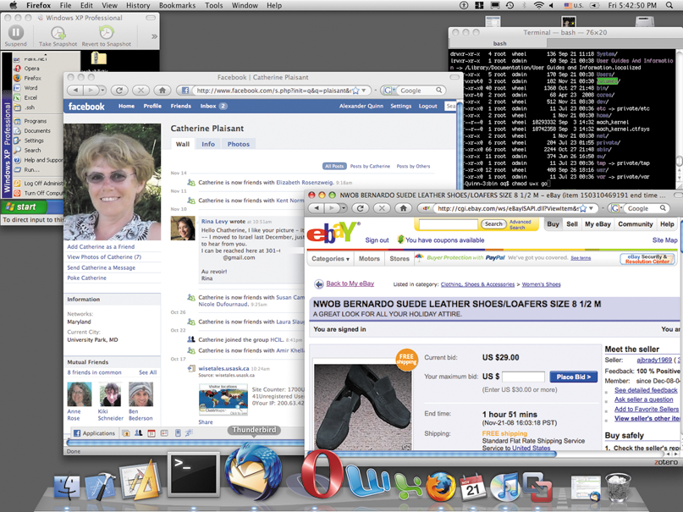
Operating System Interfaces
The new “look and feel” of Mac
1-<number>

Slide 9

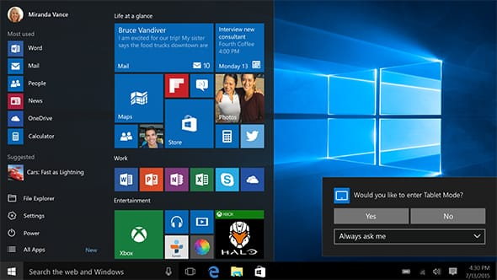
Operating System interfaces
The new “look and feel” of Windows 10
1-<number>

Slide 10
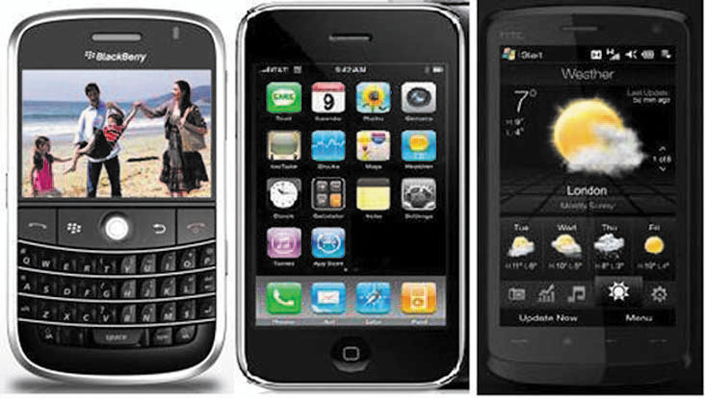
Smart phone interfaces
And smaller devices doing more…
1-<number>

Slide 11
What fields does HCI cover?
Computer Science
Psychology (cognitive)
Communication
Education
Anthropology (the study of humankind)
Design (e.g. graphic and industrial)
Ergonomics

Slide 12
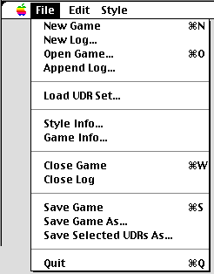
HCI Community
Academics/Industry Research
  Taxonomies
  Theories
  Predictive models
Experimenters
  Empirical data
  Product design
Other areas (Sociologists, anthropologists, managers)
  Motor
  Perceptual
  Cognitive
  Social, economic, ethics

Slide 13
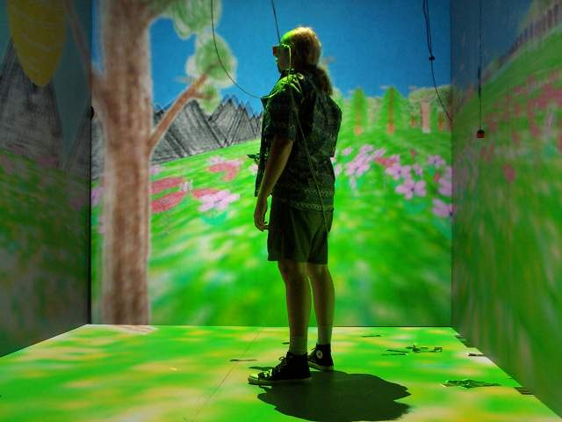
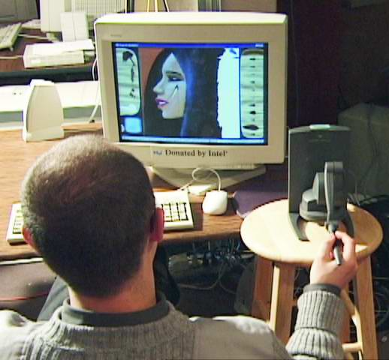
HCI Tools
Sound
3D
Animation
Video
Devices
  Size (small->very large)
  Portable (PDA, phone)
Context sensitive/aware
Personalizable
Ubiquitous

Slide 14
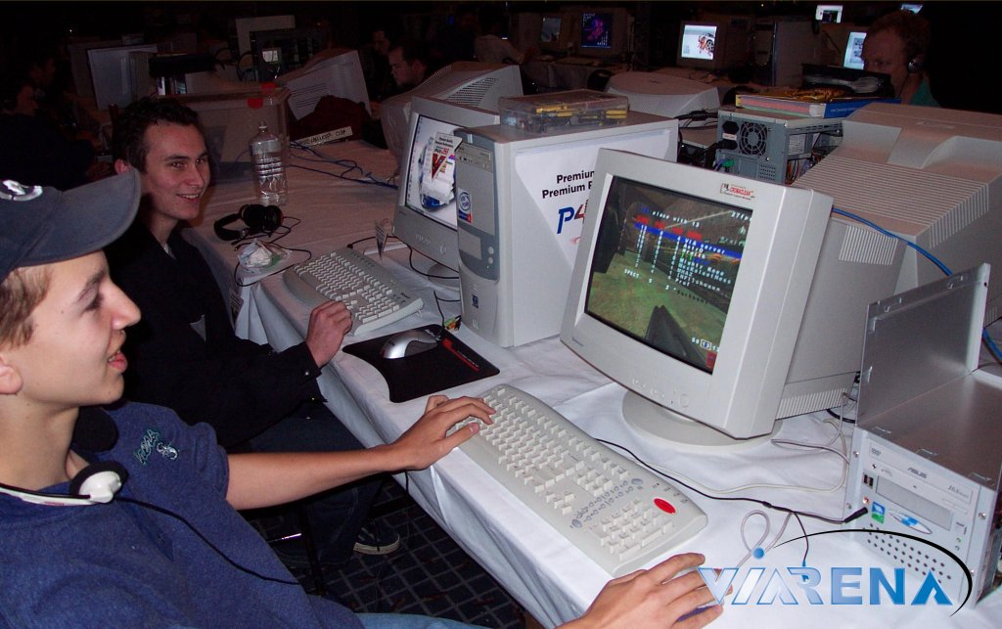
Usability Requirements
Goals:
  Usability
  Universality
  Usefulness
Achieved by:
  Planning
  Sensitivity to user needs
  Devotion to requirements analysis
  Testing

Slide 15
Usability requirements
Synonyms for “user-friendly” in Microsoft Word 2002 are easy to use; accessible; comprehensible; intelligible; available; and ready
But a “friend” also seeks to help and be valuable. A friend is not only understandable, but understands. A friend is reliable and doesn’t hurt. A friend is pleasant to be with.
These measures are still subjective and vague, so a systematic process is necessary to develop usable systems for specific users in a specific context
1-<number>

Slide 16
Usability measures
Define the target user community and class of tasks associated with the interface
5 human factors central to community evaluation:
  Time to learn
  How long does it take for typical members of the community to learn relevant task?
  Speed of performance
  How long does it take to perform relevant benchmarks?
  Rate of errors by users
  How many and what kinds of errors are made during benchmark tasks?
  Retention over time
  Frequency of use and ease of learning help make for better user retention
  Subjective satisfaction
  Allow for user feedback via interviews, free-form comments and satisfaction scales
1-<number>

Slide 17
Usability measures (cont.)
Trade-offs in design options frequently occur.
  Changes to the interface in a new version may create consistency problems with the previous version, but the changes may improve the interface in other ways or introduce new needed functionality.
Design alternatives can be evaluated by designers and users via mockups or high-fidelity prototypes.
  The basic tradeoff is getting feedback early and perhaps less expensively in the development process versus having a more authentic interface evaluated.
1-<number>

Slide 18
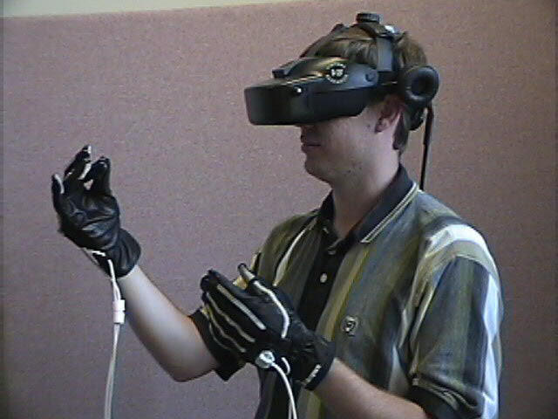
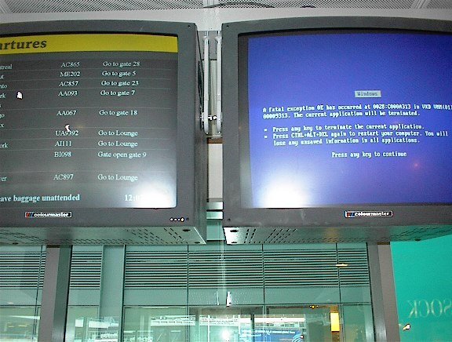
Bad Interfaces
Burdening
Confusing
Slow
Trust (ex. windows crashing)
What makes it hard?
  Varies by culture
  Multiple platforms
  Variety of users

Slide 19
Goals for requirements analysis
Ascertain the user’s needs
  Determine what tasks and subtasks must be carried out
  Include tasks which are only performed occasionally. Common tasks are easy to identify.
  Functionality must match need or else users will reject or underutilize the product
1-<number>

Slide 20
Goals for requirements analysis
Ensure reliability
  Actions must function as specified
  Database data displayed must reflect the actual database
  Appease the user's sense of mistrust
  The system should be available as often as possible
  The system must not introduce errors
  Ensure the user's privacy and data security by protecting against unwarranted access, destruction of data, and malicious tampering
1-<number>

Slide 21
Goals for requirements analysis
Promote standardization, integration, consistency, and portability
  Standardization: use pre-existing industry standards where they exist to aid learning and avoid errors (e.g. the W3C and ISO standards)
  Integration: the product should be able to run across different software tools and packages (e.g. Unix)
  Consistency:
    compatibility across different product versions
    compatibility with related paper and other non-computer based systems
    use common action sequences, terms, units, colors, etc. within the program
  Portability: allow for the user to convert data across multiple software and hardware environments
1-<number>

Slide 22

Goals for requirements analysis
Complete projects on time and within budget
Late or over budget products can create serious pressure within a company and potentially mean dissatisfied customers and loss of business to competitors
1-<number>

Slide 23
Case Study: Library of Congress Database Design
http://catalog.loc.gov/
Two interfaces
  Catalog New Books
    3-6 hour training course - staffers
  Search Catalog of Books
    General public – too complex, command language and complex cataloging rules
Solution
  Touch screen
  Reduced functionality
  Better information presentation
Eventually Web based interface
Same database and services, different interfaces

Slide 24
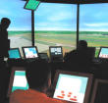

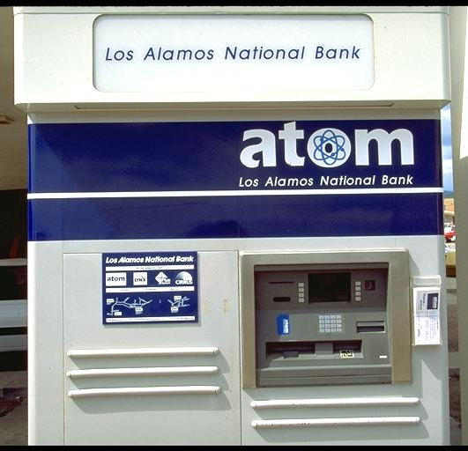
Usability Measures
How can we measure the ‘goodness’ of an interface?
What are good metrics?
ISO 9241
  Effectiveness
  Efficiency
  Satisfaction
Schneiderman
  Time to learn
  Speed of performance
  Rate of errors
  Retention over time
  Subjective satisfaction

Slide 25
Usability motivations
Many interfaces are poorly designed and this is true across domains:
Life-critical systems
  Air traffic control, nuclear reactors, power utilities, police & fire dispatch systems, medical equipment
  High costs, reliability and effectiveness are expected
  Lengthy training periods are acceptable despite the financial cost to provide error-free performance and avoid the low frequency but high cost errors
  Subject satisfaction is less an issue due to well motivated users
1-<number>

Slide 26
Usability motivations (cont.)
Industrial and commercial uses
  Banking, insurance, order entry, inventory management, reservation, billing, and point-of-sales systems
  Ease of learning is important to reduce training costs
  Speed and error rates are relative to cost
  Speed of performance is important because of the number of transactions
  Subjective satisfaction is fairly important to limit operator burnout
1-<number>

Slide 27
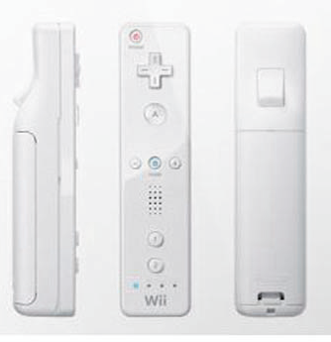
Usability motivations (cont.)
Office, home, and entertainment applications
  Word processing, electronic mail, computer conferencing, and video game systems, educational packages, search engines, mobile device, etc.
  Ease of learning, low error rates, and subjective satisfaction are paramount due to use is often discretionary and competition fierce
  Infrequent use of some applications means interfaces must be intuitive and easy to use online help is important
  Choosing functionality is difficult because the population has a wide range of both novice and expert users
  Competition cause the need for low cost
  New games and gaming devices!
    For example, Nintendo Wii, Kinect
1-<number>

Slide 28
Usability motivations (cont.)
Exploratory, creative, and cooperative systems
  Web browsing, search engines, artist toolkits, architectural design, software development, music composition, and scientific modeling systems
  Collaborative work
  Benchmarks are hard to describe for exploratory tasks and device users
  With these applications, the computer should be transparent so that the user can be absorbed in their task domain
1-<number>

Slide 29
Usability motivations (cont.)
Social-technical systems
  Complex systems that involve many people over long time periods
  Voting, health support, identity verification, crime reporting
  Trust, privacy, responsibility, and security are issues
  Verifiable sources and status feedback are important
  Ease of learning for novices and feedback to build trust
  Administrators need tools to detect unusual patterns of usage
1-<number>

Slide 30
Universal Usability
Physical abilities and physical workplaces
  Basic data about human dimensions comes from research in anthropometry
  There is no average user, either compromises must be made or multiple versions of a system must be created
  Physical measurement of human dimensions are not enough, take into account dynamic measures such as reach, strength or speed
1-<number>

Slide 31
Universal Usability (cont.)
  Screen-brightness preferences vary substantially, designers customarily provide a knob to enable user control
  Account for variances of the user population's sense perception
  Vision: depth, contrast, color blindness, and motion sensitivity
  Touch: keyboard and touchscreen sensitivity
  Hearing: audio clues must be distinct
  Workplace design can both help and hinder work performance
1-<number>

Slide 32
Universal Usability (cont.)
The standard ANSI/HFES 100-2007 Human Factors Engineering of Computer Workstations (2007) lists these concerns:
  Work-surface and display-support height
  Clearance under work surface for legs
  Work-surface width and depth
  Adjustability of heights and angles for chairs and work surfaces
  Posture - seating depth and angle; back-rest height and lumbar support
  Availability of armrests, footrests, and palmrests
1-<number>

Slide 33
Universal Usability (cont.)
Cognitive and perceptual abilities
  The human ability to interpret sensory input rapidly and to initiate complex actions makes modern computer systems possible
  The journal Ergonomics Abstracts offers this classification of human cognitive processes:
    Long-term and semantic memory
    Short-term and working memory
    Problem solving and reasoning
    Decision making and risk assessment
    Language communication and comprehension
    Search, imagery, and sensory memory
    Learning, skill development, knowledge acquisition, and concept attainment
1-<number>

Slide 34
Universal Usability (cont.)
  They also suggest this set of factors affecting perceptual and motor performance:
    Arousal and vigilance
    Fatigue and sleep deprivation
    Perceptual (mental) load
    Knowledge of results and feedback
    Monotony and boredom
    Sensory deprivation
    Nutrition and diet
    Fear, anxiety, mood, and emotion
    Drugs, smoking, and alcohol
    Physiological rhythms
  But note, in any application, background experience and knowledge in the task domain and the interface domain play key roles in learning and performance
1-<number>

Slide 35
Universal Usability (cont.)
Personality differences
  There is no set taxonomy for identifying user personality types
  Designers must be aware that populations are subdivided and that these subdivisions have various responses to different stimuli
  Myers-Briggs Type Indicator (MBTI)
    extroversion versus introversion
    sensing versus intuition
    perceptive versus judging
    feeling versus thinking
1-<number>
Notes:
Extroverts appear outgoing and are energized by people, and are very effective in pursuits that involve other people. Extroverts tend to be sensation-seeking, spontaneous, and gregarious. They enjoy crowds, noise, and stimulation.
Introverts are rested and energized by solitude, and are very effective in solitary pursuits. An introvert is a person who prefers to process thoughts internally. Introverts tend to think before they speak. The word is also used informally to refer to somebody who prefers solitary activities to social ones. Introverts tend to be seen as quiet and reserved, which is often confused with a lack of confidence by louder, more extroverted people. They often perform well in analytical roles that require intelligence or logic, but place less emphasis on social interactions and "people skills". Introverts are usually a minority in the general population, and they can often be sidelined by culture or society, which in many cases favours the more common extroverted style of behaviour.
Sensors want, trust, and remember facts, and usually describe themselves as "practical". For a Sensor, intuition is untrustworthy and might seem like mental static. Sensation as a perceiving mode of consciousness focuses on heightening reality. Guardians share the combination SJ, while Artisans share the combination SP.
Intuitives prefer metaphor, analogy, and logic, and tend to reason from first principles and hunches. While Sensors pride themselves on living in the real world, Intuitives pride themselves on seeing possibilities. This can cause conflict. Intuition as a perceiving mode of consciousness filters experience through the unconscious mind. Intuition focuses on possibilities rather than realities. Idealists share the combination NF, while Rationals share the combination NT.
Thinkers use objective means of reasoning: logic and verifiable experience.
Feelers prefer personal reasoning: value judgements and emotions. Thinkers often find Feelers muddle-headed. Feelers often find Thinkers cold and inhuman.
Judgers prefer to come to decisions, and move on. They may feel betrayed if a decision is "reopened". They are prone to rashness, but get things done.
Perceivers prefer to leave their options open to perceive new possibilities and processes as long as possible. They tend to mourn opportunities lost to premature decisions. They are prone to analysis paralysis, but rarely make permanent mistakes.

Slide 36
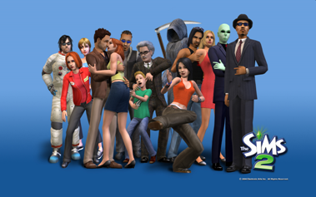
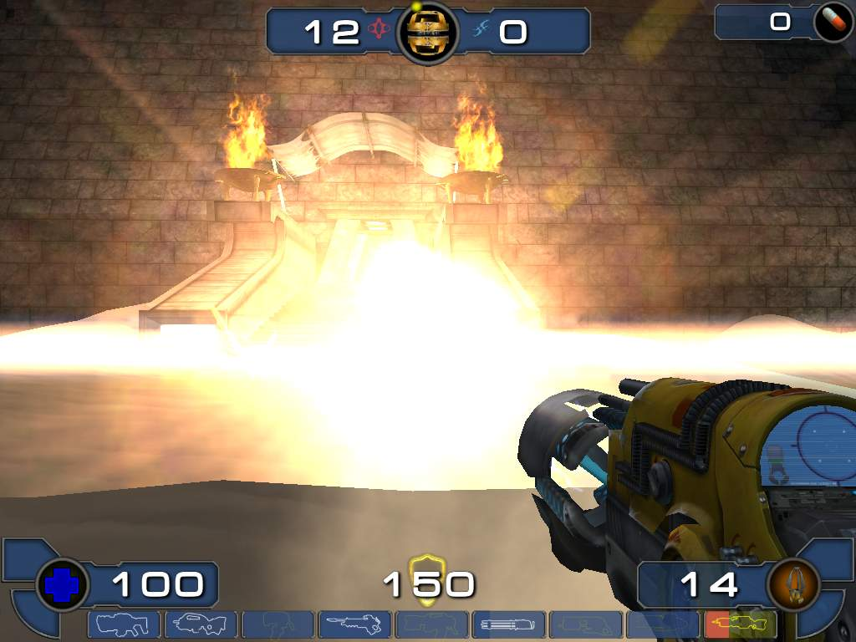
Universal Usability (cont.)
Personality differences
Computer anxiety
Gender
  Which games do women like?
  Pac-man, Donkey Kong, Tetris
  Why? (Hypotheses: less violent, quieter soundtracks, fully visible playing fields, softer colors, personality, closure/completeness)
  Can we measure this?
What current games are for women?
Style, pace, top-down/bottom-up, visual/audio learners, dense vs. sparse data

Slide 37
Universal Usability (cont.)
Cultural and international diversity
  Characters, numerals, special characters, and diacritical
  Left-to-right versus right-to-left versus vertical input and reading
  Date and time formats
  Numeric and currency formats
  Weights and measures
  Telephone numbers and addresses
  Names and titles (Mr., Ms., Mme.)
  Social-security, national identification, and passport numbers
  Capitalization and punctuation
  Sorting sequences
  Icons, buttons, colors
  Pluralization, grammar, spelling
  Etiquette, policies, tone, formality, metaphors
1-<number>

Slide 38
Universal Usability (cont.)
Users with physical challenges
Federal law to ensure access to IT, including computers and web sites. (1998 Amendment to Rehabilitation Act)
Disabilities
  Vision
    Blind
    low-vision
    color-blind
  Hearing
    Deaf
    Limited hearing
  Mobility
  Learning
    Dyslexia
    Attention deficient, hemisphere specific, etc.
Keyboard and mouse alternatives
Color coding, Font-size
1-<number>

Slide 39
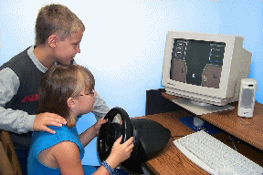
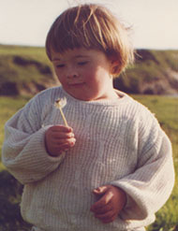
Users with Disabilities
Contrast
Text descriptors for web images
Screen magnification
Text to Speech (TTS) – JAWS (web pages)
  Check email on the road, in bright sunshine, riding a bike
Speech Recognition
Head mounted optical mice

Slide 40
Users with Disabilities
Eye Gaze control
Learning what helps those with disabilities affects everyone
  Present procedures, directions, and instructions accessible to even poor readers
  Design feedback sequences that explain the reason for error and help put users on the right track
  Reinforcement techniques with other devices

Slide 41
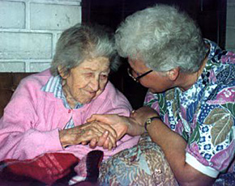
Elderly
Reduced
  Motor skills
  Perception
  Vision, hearing, touch, mobility
  Speed
  Memory
Other needs
  Technology experience is varied (How many grandmothers use email? mothers?)
  Uninformed on how technology could help them
  Practice skills (hand-eye, problem solving, etc.)
Touch screens, larger fonts, louder sounds

Slide 42
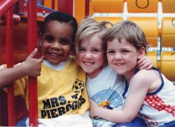
Children
Technology saviness?
Age changes much:
  Physical dexterity
    (double-clicking, click and drag, and small targets)
  Attention span
  (vaguely) Intelligence
Varied backgrounds (socio-economic)
Goals
  Educational acceleration
  Socialization with peers
  Psychological - improve self-image, self-confidence
  Creativity – art, music, etc. exploration

Slide 43
Children
Teenagers are a special group
  Next generation
  Beta test new interfaces, trends
  Cell phones, text messages, simulations, fantasy games, virtual worlds
Requires Safety
They
  Like exploring (easy to reset state)
  Don’t mind making mistakes
  Like familiar characters and repetition (ever had to babysit a kid with an Ice Age DVD?)
  Don’t like patronizing comments, inappropriate humor
Design: Focus groups

Slide 44
Accommodating Hardware and Software Diversity
Support a wide range of hardware and software platforms
Software and hardware evolution
  OS, application, browsers, capabilities
  backward compatibility is a good goal
Three major technical challenges are:
  Producing satisfying and effective Internet interaction (broadband vs. dial-up & wireless)
  Enabling web services from large to small (size and resolution)
  Support easy maintenance of or automatic conversion to multiple languages

Slide 45
HCI Goals
Influence academic and industrial researchers
  Understand a problem and related theory
  Hypothesis and testing
  Study design (we’ll do this!)
  Interpret results
Provide tools, techniques and knowledge for commercial developers
  competitive advantage (think ipod)
Raising the computer consciousness of the general public
  Reduce computer anxiety (error messages)
  Common fears:
    I’ll break it
    I’ll make a mistake
    The computer is smarter than me
  HCI contributes to this!

